Slide 1
How to build an NMR spectrometer?
Biological NMR
www.bionmr.ethz.ch
… or NMR for everyone
Takuya Segawa
BioNMR group seminar
November 3, 2022

Slide 2
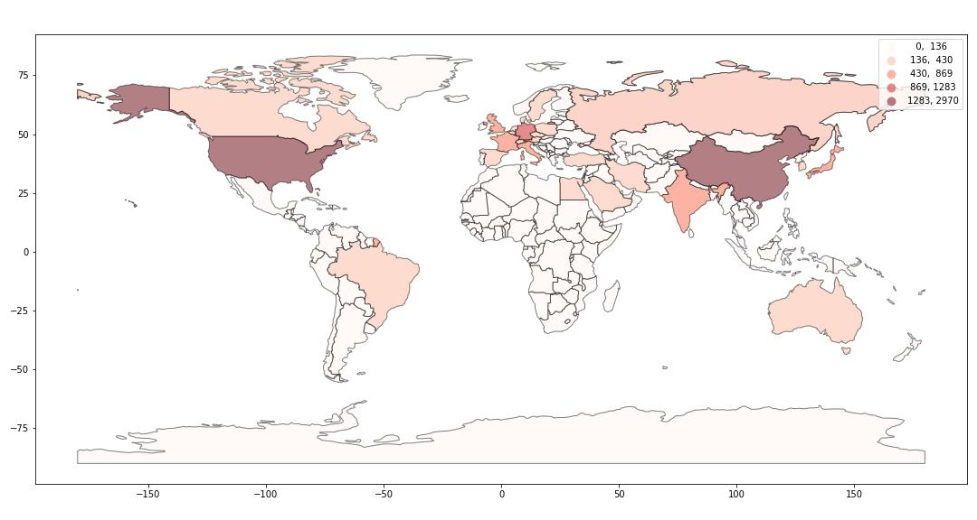
The NMR world map
Top 10
China
United States
Germany
United Kingdom
India
France
Japan
Italy
Russian Federation
Citations in Scopus (2021), keyword = NMR, by Maria Pechlaner (Infozentrum)

Slide 3
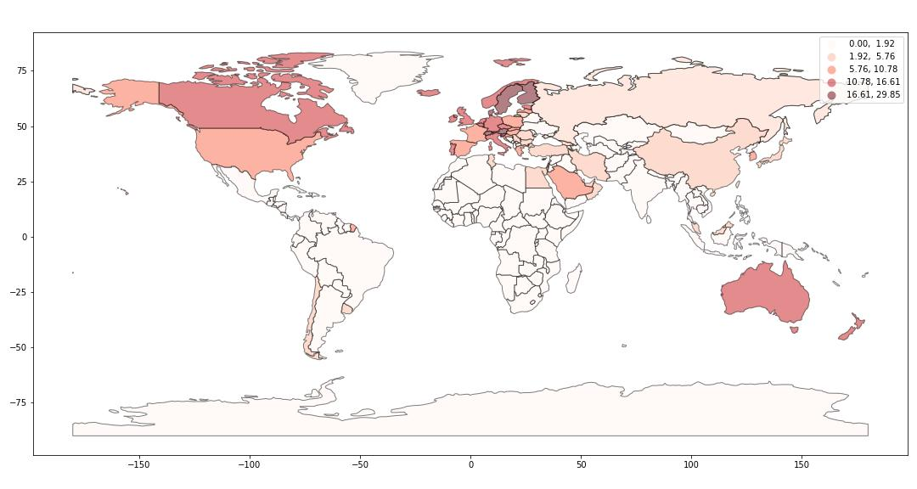
The NMR world map (per capita)
Top 10
Switzerland
Denmark
Slovenia
Sweden
Finland
Austria
Iceland
Luxembourg
Netherlands
Citations in Scopus (2021), keyword = NMR, by Maria Pechlaner (Infozentrum)

Slide 4
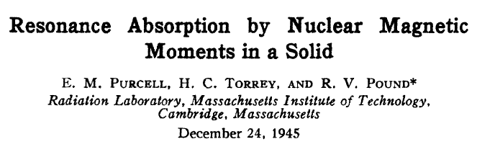
Inaccessibility of NMR in the «Global South»
No NMR, because of…
…prohibitive procurement costs
…high operating costs
…inaccessibility of liquid Helium
Without NMR spectroscopy…
…no chemical structure determination
…no «hands-on» quantum physics experiment
…exclusion from 75-years-old MR technology
To change this, we need…
…a cheap NMR spectrometer
…a cryogen-free NMR spectrometer
…an open-source NMR spectrometer / community
Roland:
«CHF 10’000 NMR spectrometer»
photo-CIDNP signal enhancement
Smartphone App controlled
for education and research

Slide 5
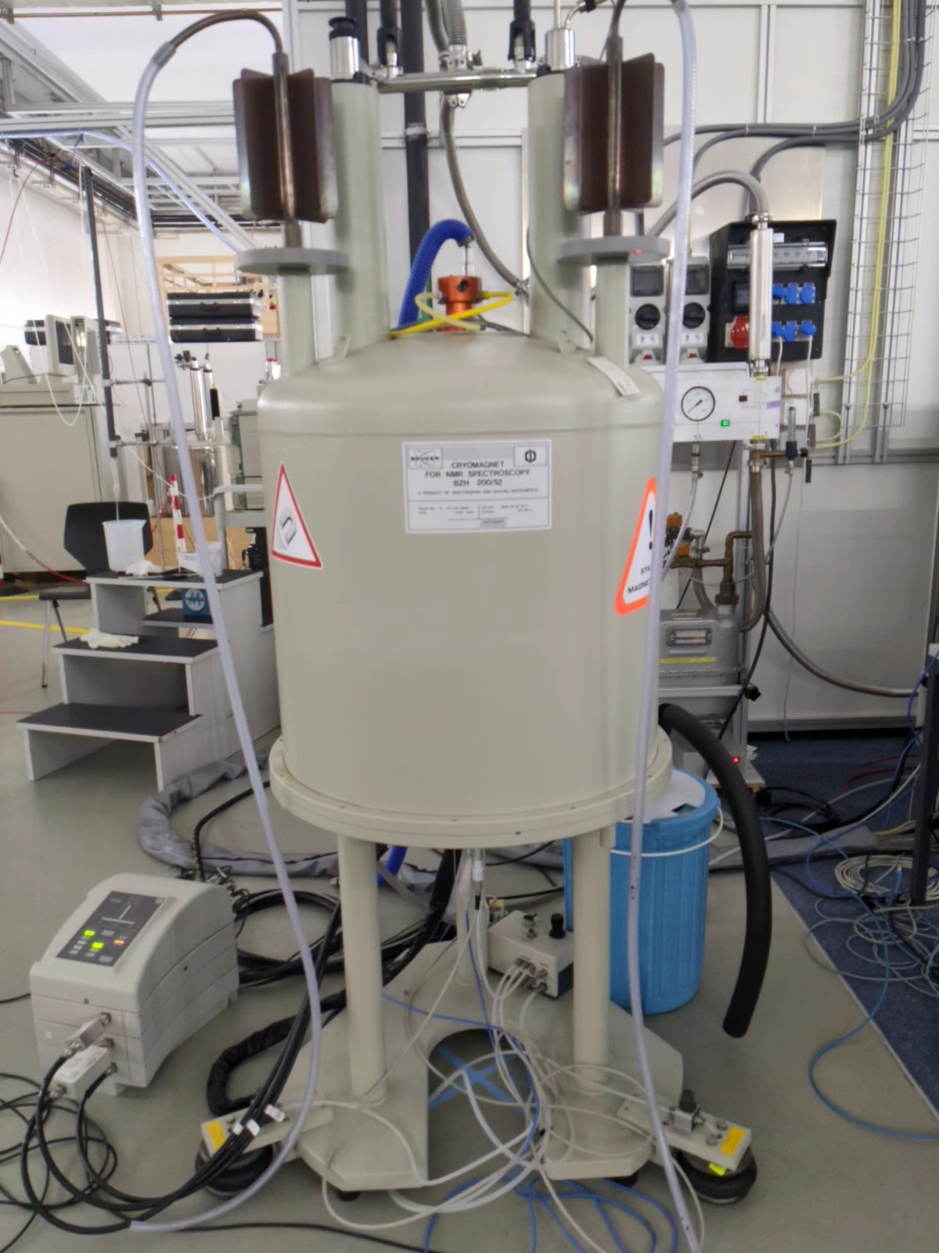
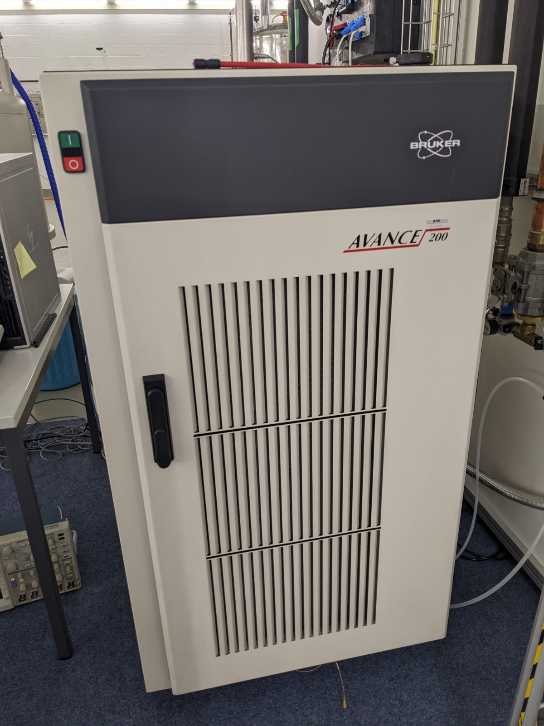
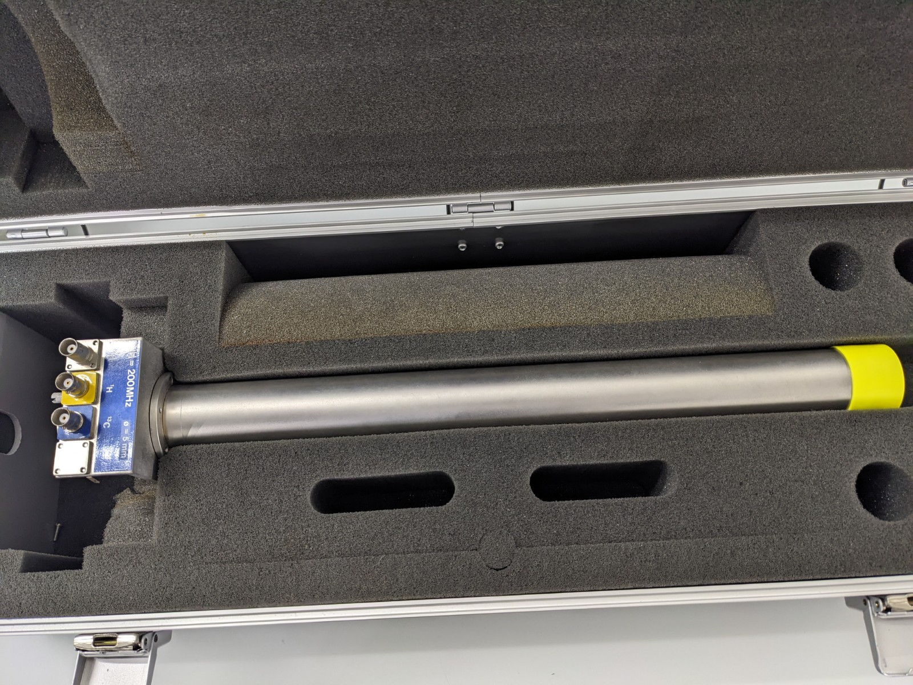
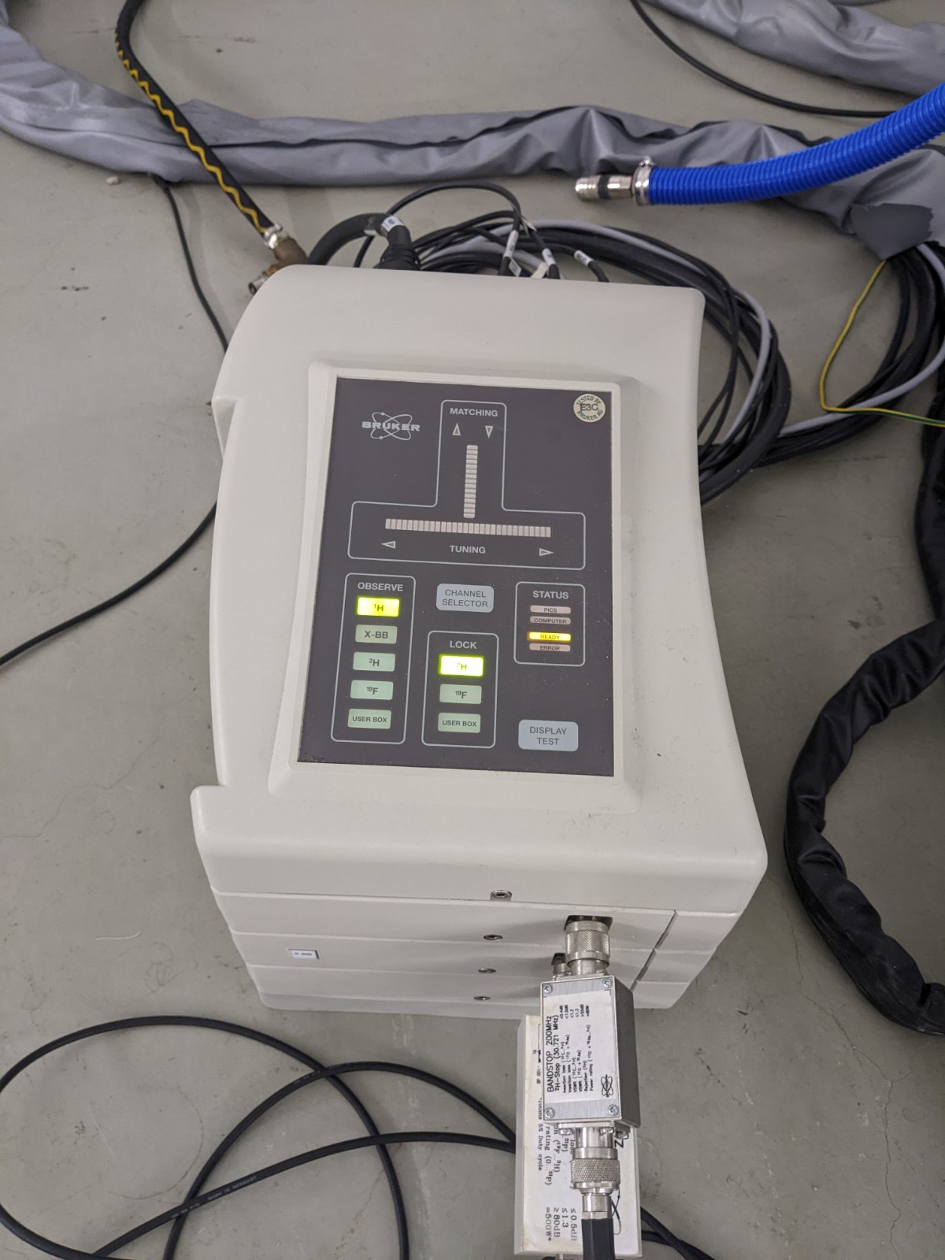
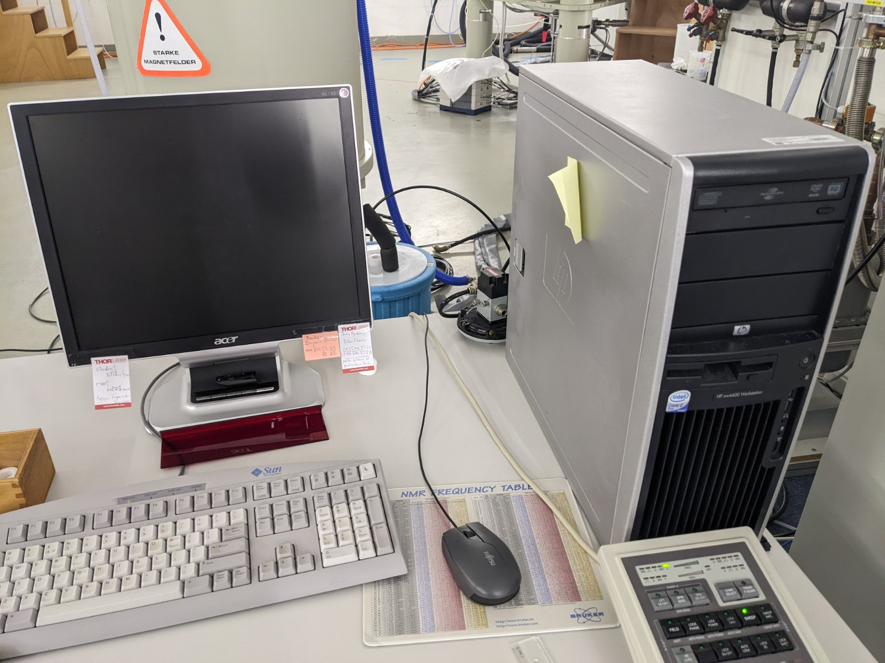
Building an NMR spectrometer: The ingredients
Console
Magnet
Probe
Preamp
Computer

Slide 6
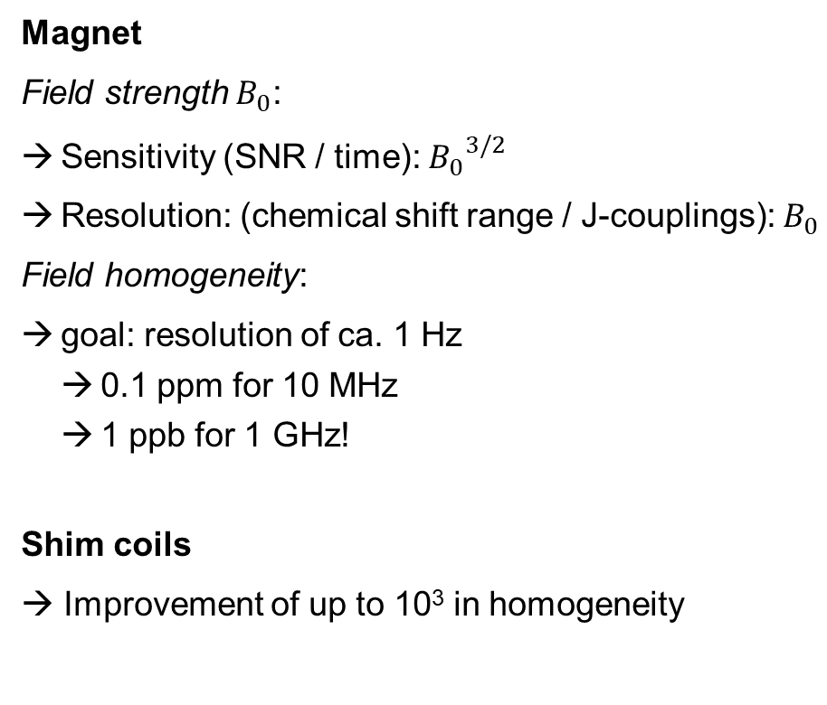
Building an NMR spectrometer: The ingredients
Magnet
Field strength $B_{0}$:
Sensitivity (SNR / time): ${B_{0}}^{3/2}$
Resolution: (chemical shift range / J-couplings): $B_{0}$
Field homogeneity:
goal: resolution of ca. 1 Hz
0.1 ppm for 10 MHz
1 ppb for 1 GHz!
Shim coils
→ Improvement of up to 10³ in homogeneity
Probe
RF coil for transmission and reception with LC circuit for tuning and matching → for every channel
Console
RF frequency, RF pulse, amplifier, RF detection, digitizer, clock, etc. → for every channel
Preamplifier
low-noise amplifier & transmitter/receiver switch
Computer
→ Data: processing and display

Slide 7

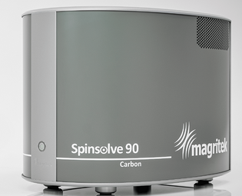
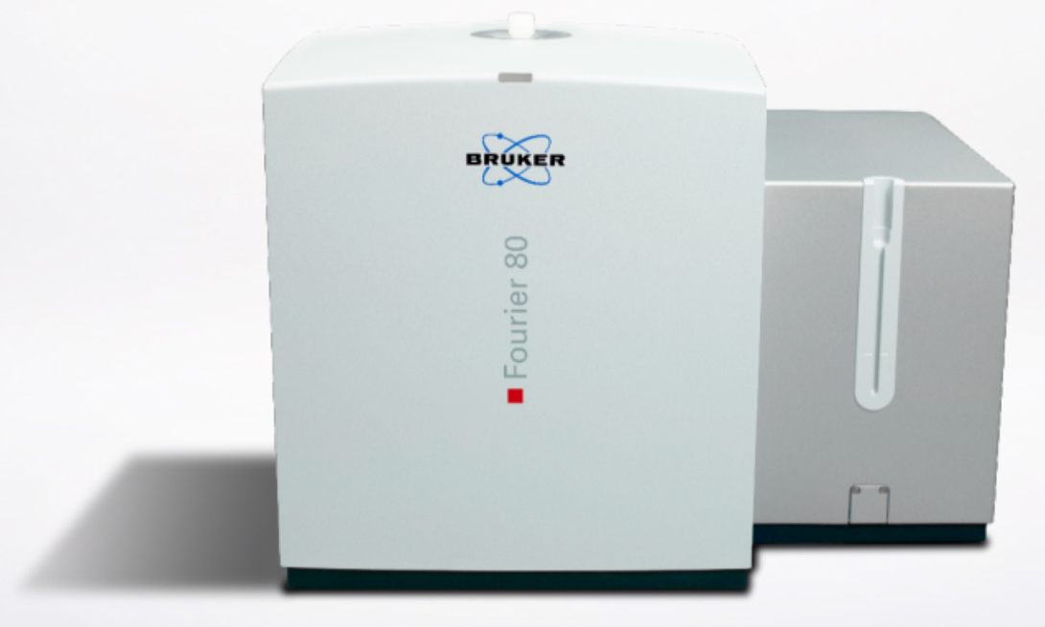
Benchtop NMR – The market
Bruker, Fourier 80
CHF 100’000 – 150’000
Topspin software
External lock on ¹⁹F
option: gradients, temperature (25 – 60 °C)
100 kg
¹H sensitivity (1% Ethyl Benzene): ≥ 240:1
Magritek, Spinsolve 90
Spinsolve series on the market since 2012
CHF ?
Broadband probe: ¹H, ¹⁹F, ¹³C, ³¹P, ⁷Li, ¹¹B, ²⁹Si, ¹²⁹Xe, ²D, ¹⁵N
3 D gradients + gradients for DOSY (optional)
115 kg
¹H sensitivity (1% Ethyl Benzene): ≥ 240:1

Slide 8
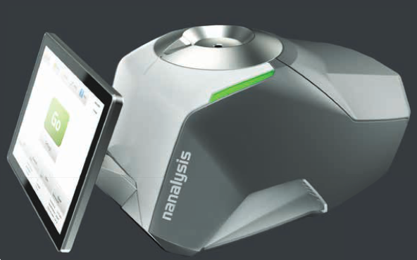
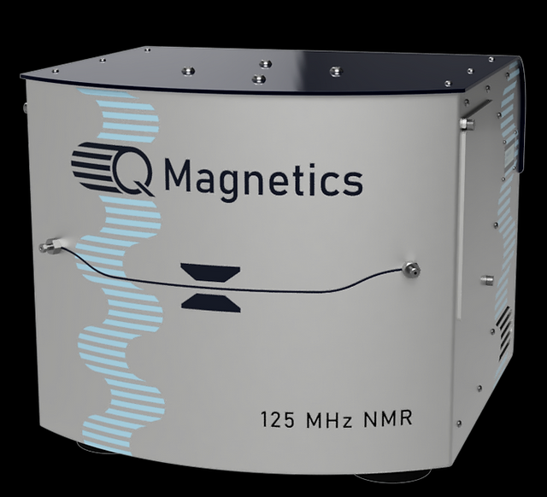
Benchtop NMR – The market
Nanalysis, 100 MHz
CHF ?
Topspin software
lock on ²H
110 kg
¹H sensitivity (1% Ethyl Benzene): >220 : 1
QMagnetics, 125 MHz
Highest-field benchtop on the market
< USD 40’000?
Software: open-source (in development?)
No lock («soft lock»)
28 kg
Active volume: only 1 μL → flow system
¹H sensitivity (1% Ethyl Benzene): ≥ 14:1

Slide 9
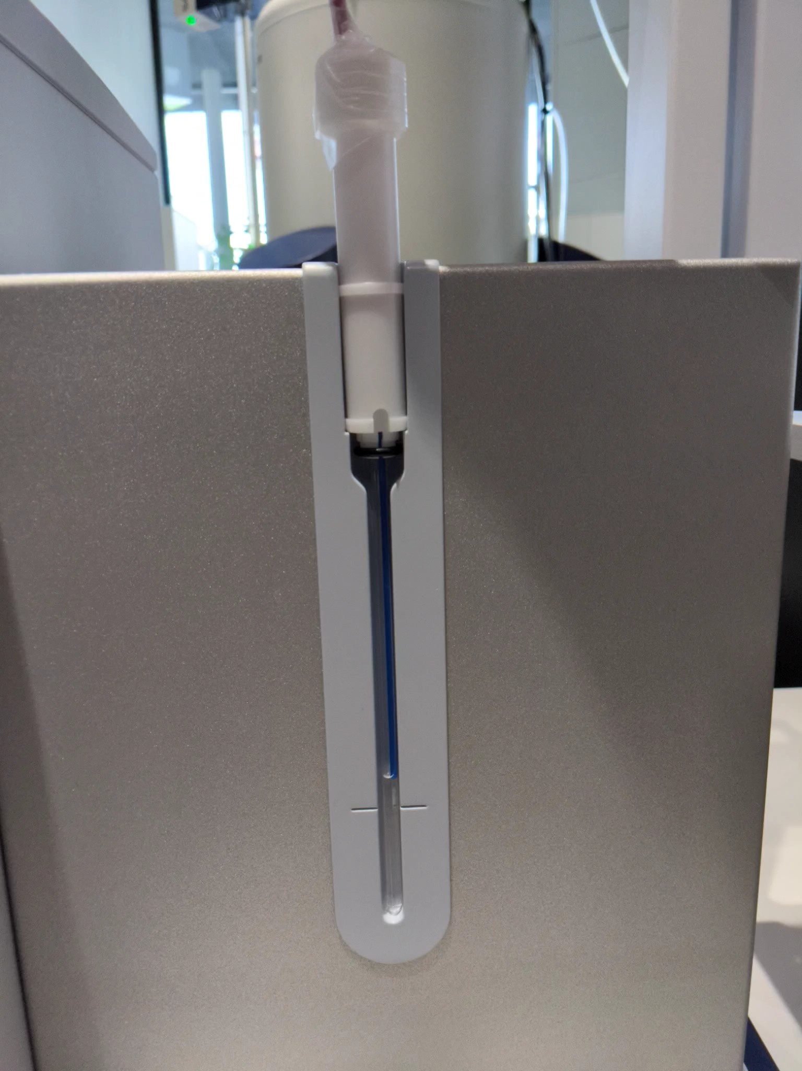
Photo-CIDNP at low field @ Fourier 80
¹H 80 MHz NMR
Molecule: 100 μM tryptophan
Dye: 25 μM fluorescein
O₂ quencher:
enzyme system glucose oxidase / catalase & 5 mM glucose
Solvent: 100 % H₂O
Pulse sequence: zgcppr (a composite pre-saturation pulse)
Laser irradiation: 450 nm, ca. 1 W, optical fiber into NMR tube
Number of scans: 4
laser off
laser on
0.1 mM tryptophan
(aromatic protons)
5 mM glucose
0.1 mM tryptophan
(aliphatic protons)
with Barbara Czarniecki (Bruker, Fällanden)

Slide 10
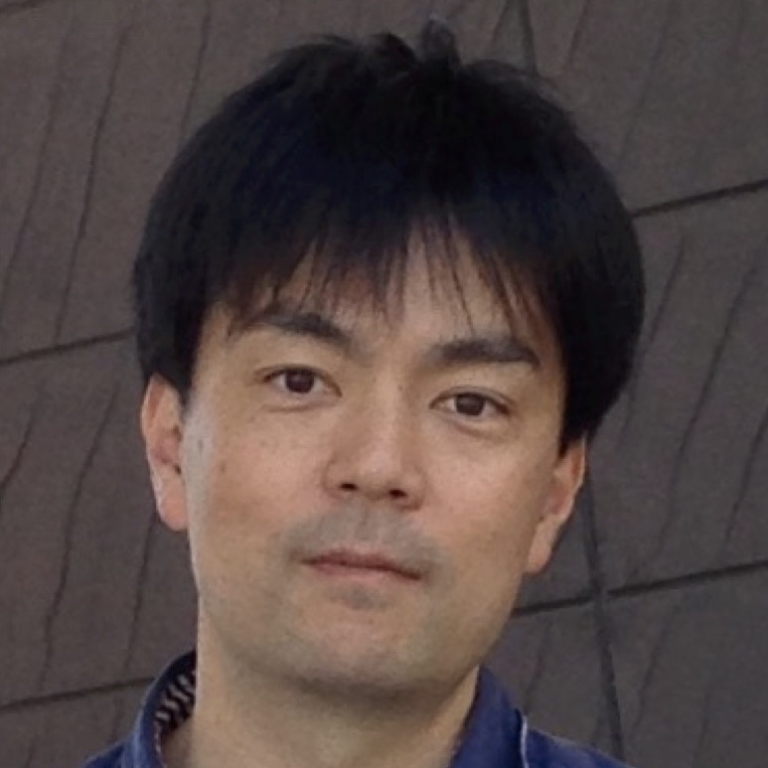
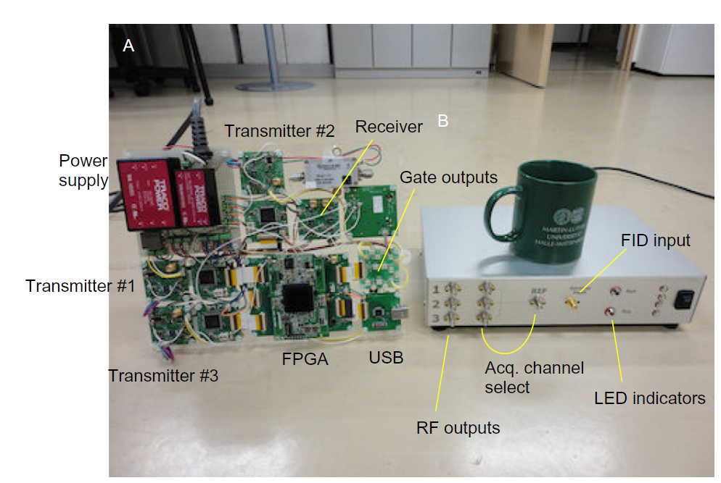
Pioneers in open-source MR: 1) Kazuyuki Takeda’s Opencore NMR (2007 – now)
Use same data format → use processing software
Core part:
Field-Programmable Gate Array (FPGA)
“Hardware becomes Software”
Performs all digital job:
pulse programmer
direct digital synthesizers
digital receiver
digital low-pass filter
PC interfaces for command/data transfer
Costs:
ca. 5000 €
Frequency range
up to 600 MHz (14 T for ¹H NMR)
K. Takeda, Highly Customized NMR Systems Using an Open-Resource, Home-Built Spectrometer, Annu. Rep. NMR Spectrosc., 74, (2001)
https://doi.org/10.1016/B978-0-08-097072-1.00007-8

Slide 11
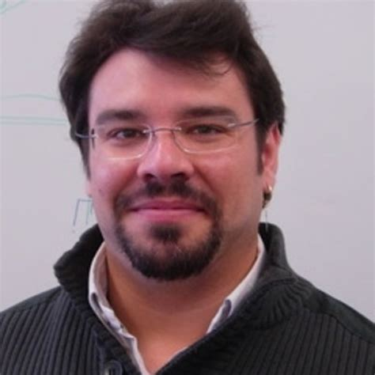
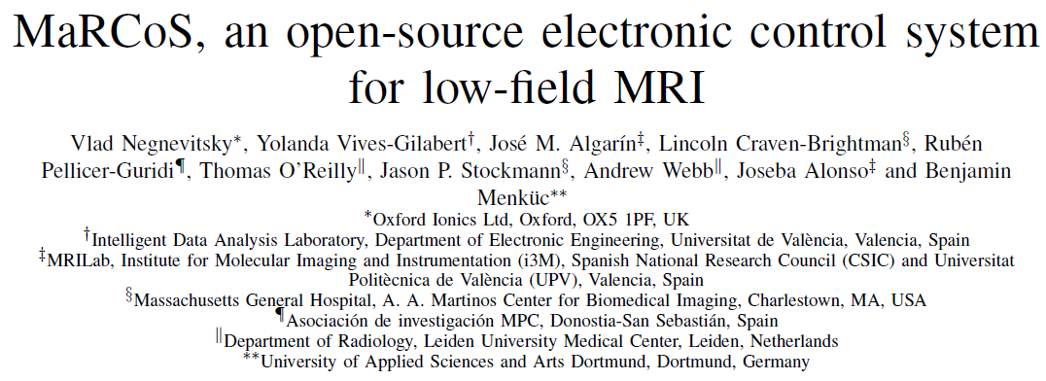
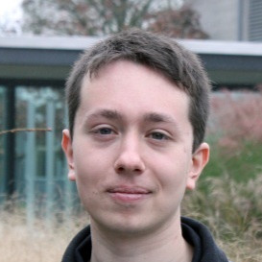
Pioneers in open-source MR : 2) Open-Source MRI
V. Negnevitsky et al. (2022), arXiv:2208.01616

Slide 12
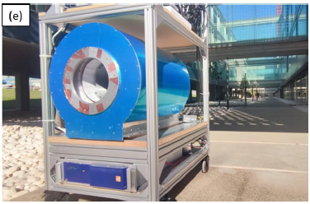
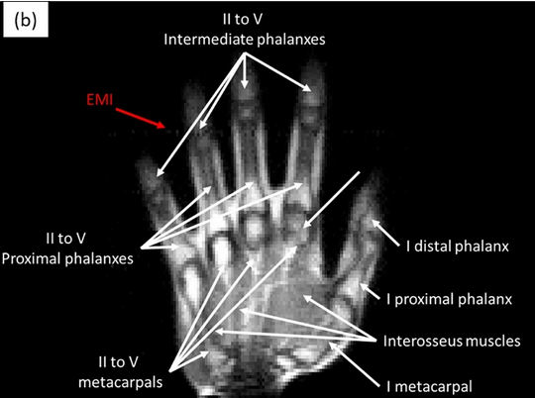
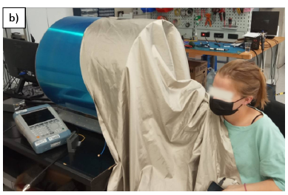
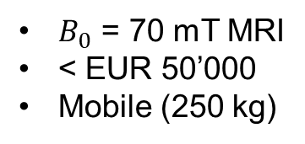
Pioneers: 2) Open-Source MRI
$B_{0}$ = 70 mT MRI
< EUR 50’000
Mobile (250 kg)
in 10 min
T. Guallart-Naval, J. Alonso et al., Sci. Rep., 12:13147 (2022) https://doi.org/10.1038/s41598-022-17472-w
T. Guallart-Naval, J. Alonso et al. (2022) arXiv:2203.11314

Slide 13
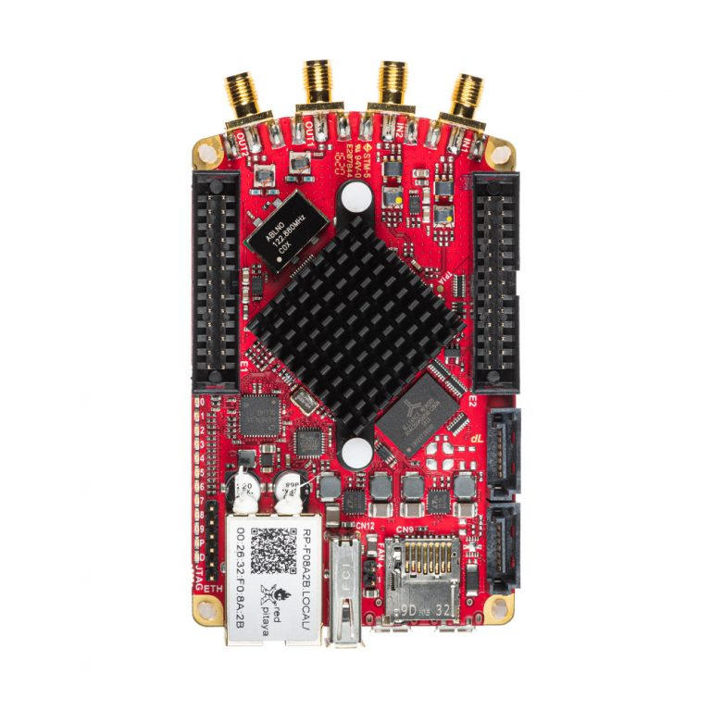
Pioneers: 2) Open-Source MRI
SDR: “software-defined radio”
EUR 500
EUR 625
Key part: SDR Lab from Red Pitaya (Slovenia)
FPGA: Xilinx Zynq 7020
2 RF inputs (16-bit resolution)
2 RF outputs (14-bit resolution)
Max. RF: 122.88 MHz
Up to ca. 60 MHz spectrometer (¹H ca. 1.5 T)
Software on an SD card (exchangeable)

Slide 14
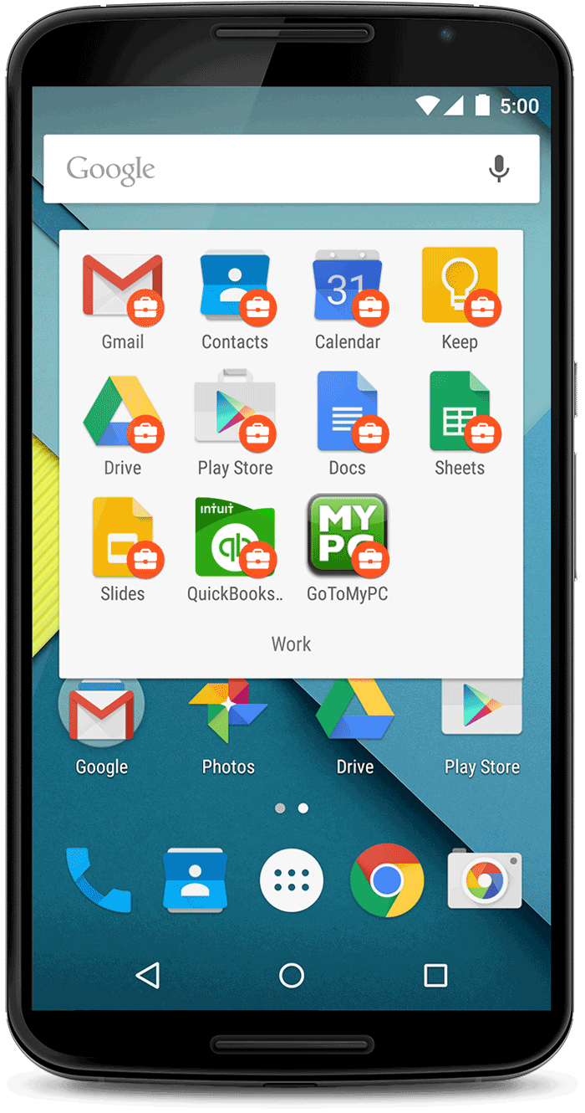
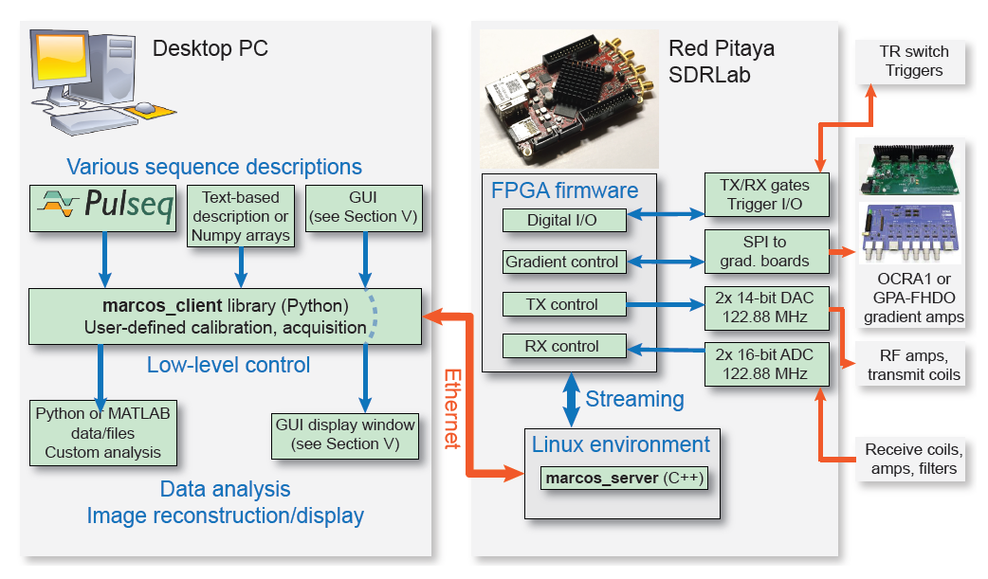

MaRCoS – “Red Pitaya”-based console
→ let’s use this as our NMR console!
ü

Slide 15
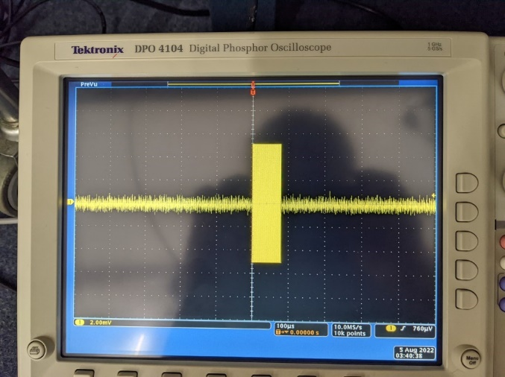
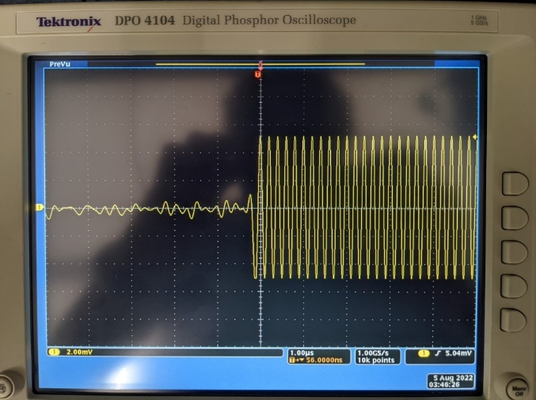
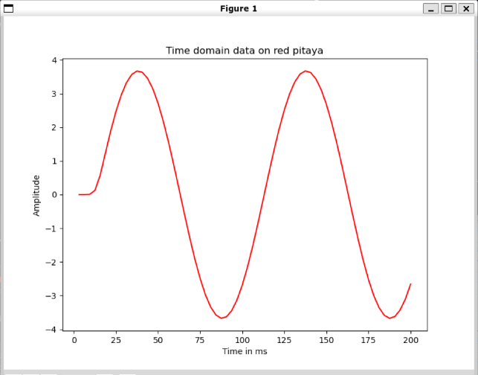
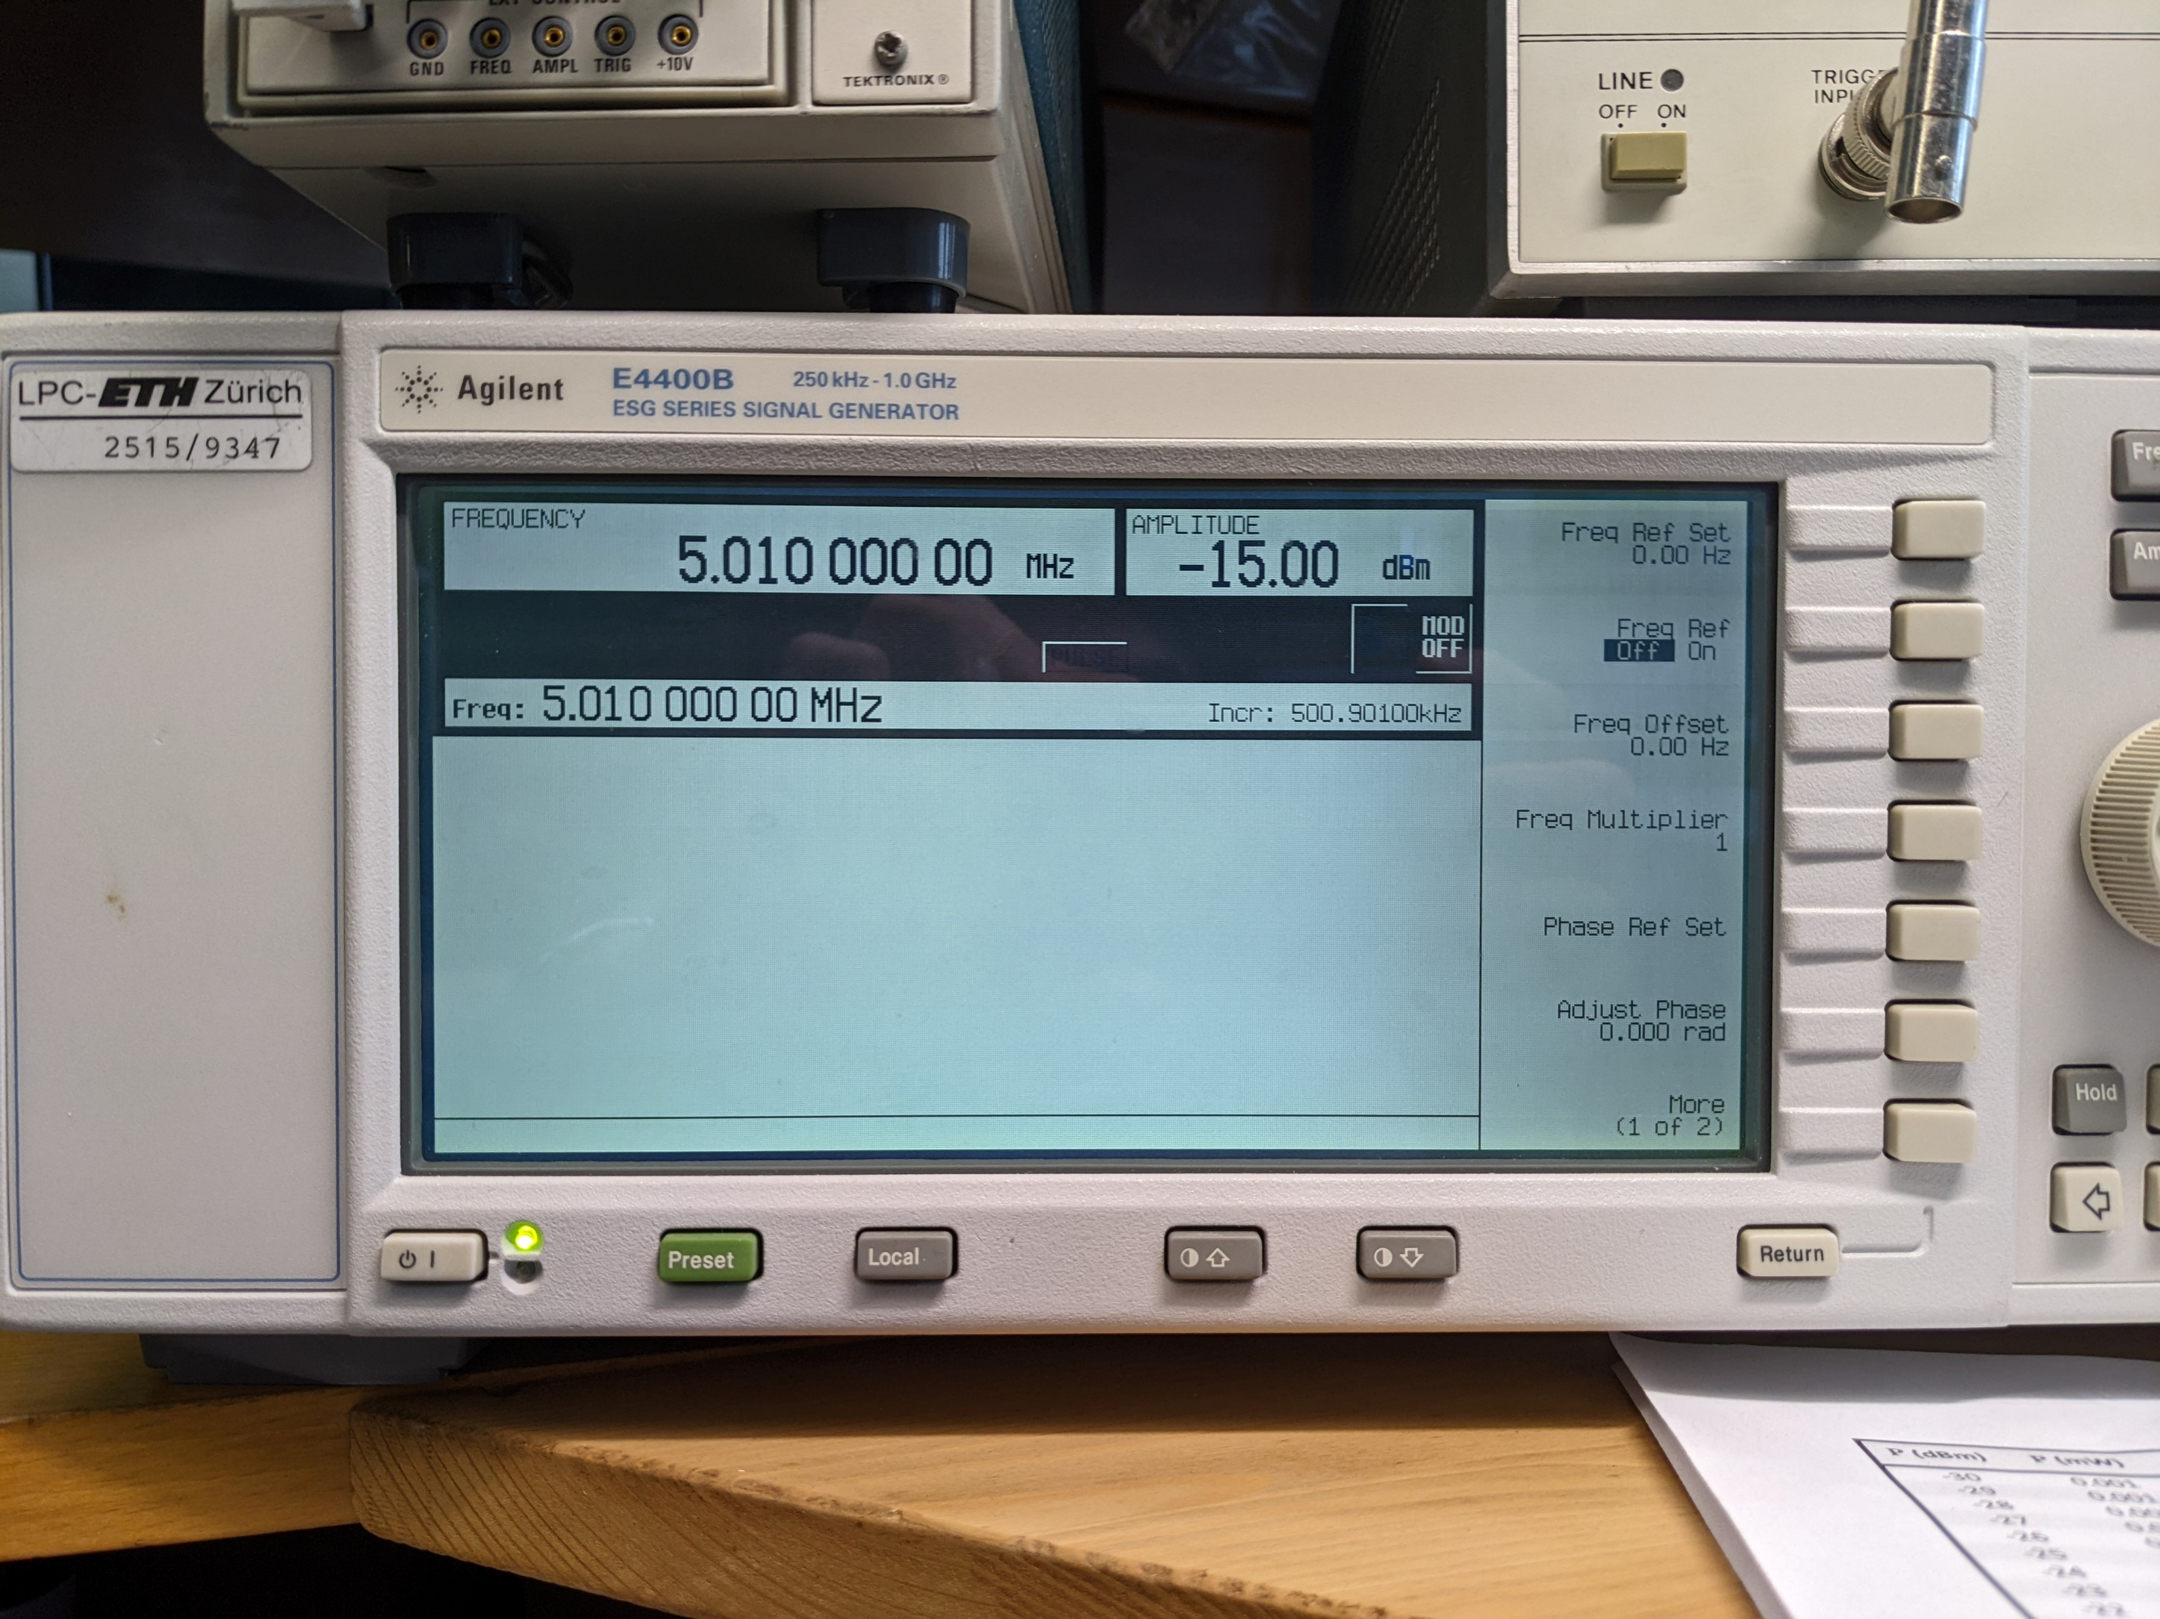
Red Pitaya @Riek Lab
24.46 MHz for 80 μs
Generation of RF pulses with defined RF:
→ Measured on oscilloscope
Detection of RF signal, sent by RF signal generator:
5.01 MHz detected with a carrier frequency of 5 MHz
10 kHz signal

Slide 16
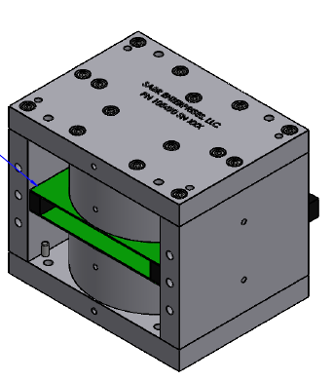
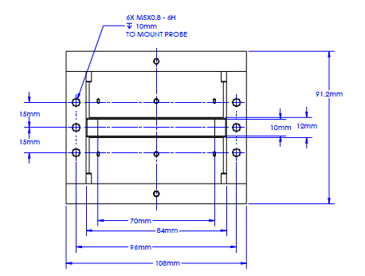
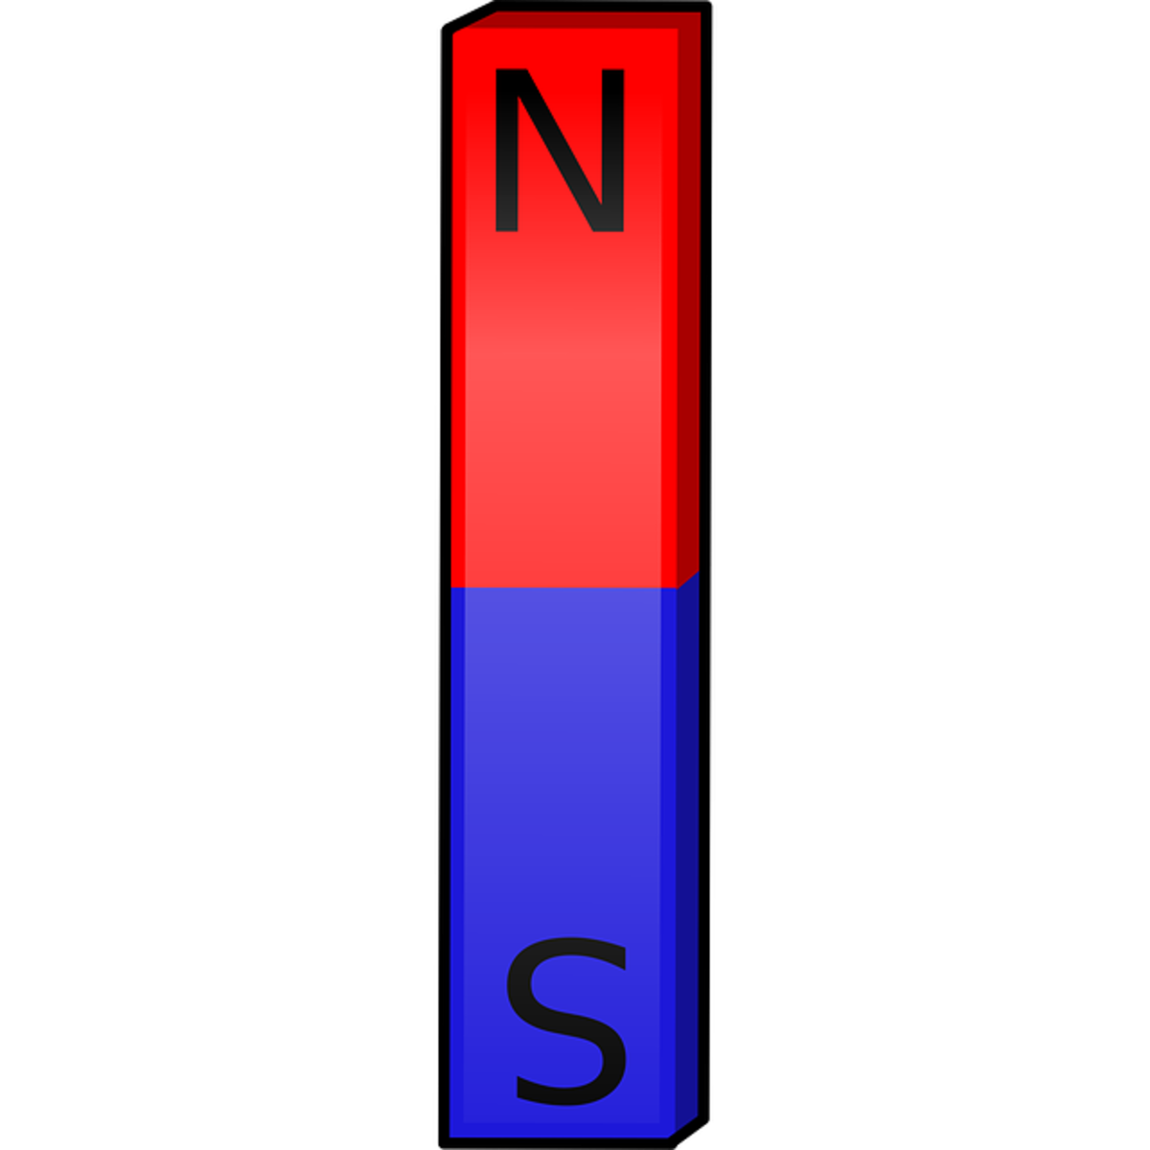
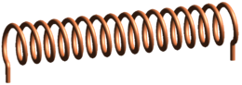
The Magnet: 0.6 T for 25 MHz ¹H NMR
Expected delivery:
end of 2022/
beginning of 2023
ü
By SABR Enterprises, LLC (USA)
Field strength:
0.6 T → 25 MHz
Homogeneous volume:
100 μL / 5 mm tube
Homogeneity:
0.1 ppm FWHM → 2.5 Hz
Magnet material:
temperature-compensated Samarium-Cobalt → 50 ppm/K
Weight:
ca. 5 kg
Price for prototype
USD 26,532.00 + VAT
Price for one magnet (N = 10)
USD 8,500.00 + VAT
Passive and active shim assembly
Solenoid coil for RF excitation/detection
ü
Ca. CHF 1000 left to build rest of spectrometer!

Slide 17
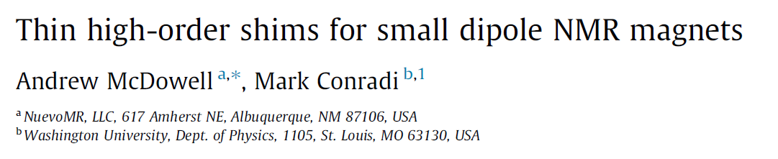
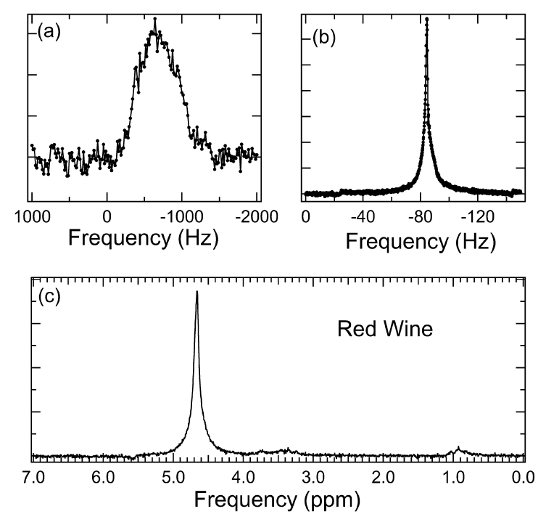
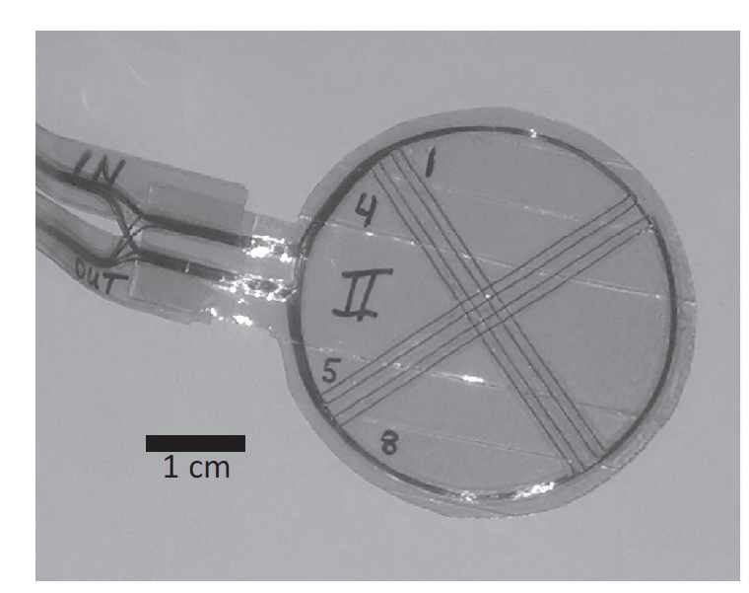
Shimming
ü
67 MHz ¹H NMR
without shim
with shim
Challenges:
No existing algorithm for «Auto-Shim»
Need of current supply (32 channels)
A. McDowell and M. Conradi, J. Magn. Reson., 281, 7 (2017)
A.F. McDowell, Magnetic Field Correction System, US Patent 9285441, 2016.

Slide 18


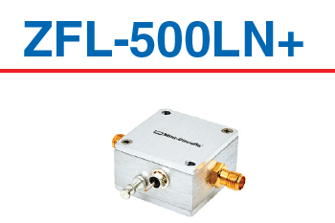
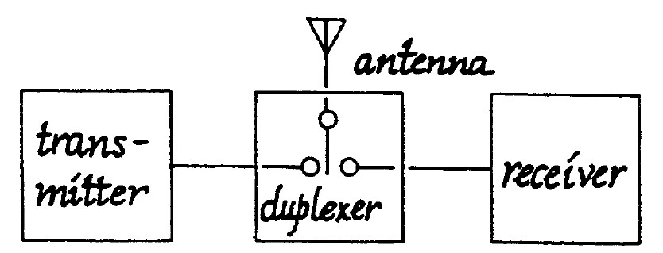
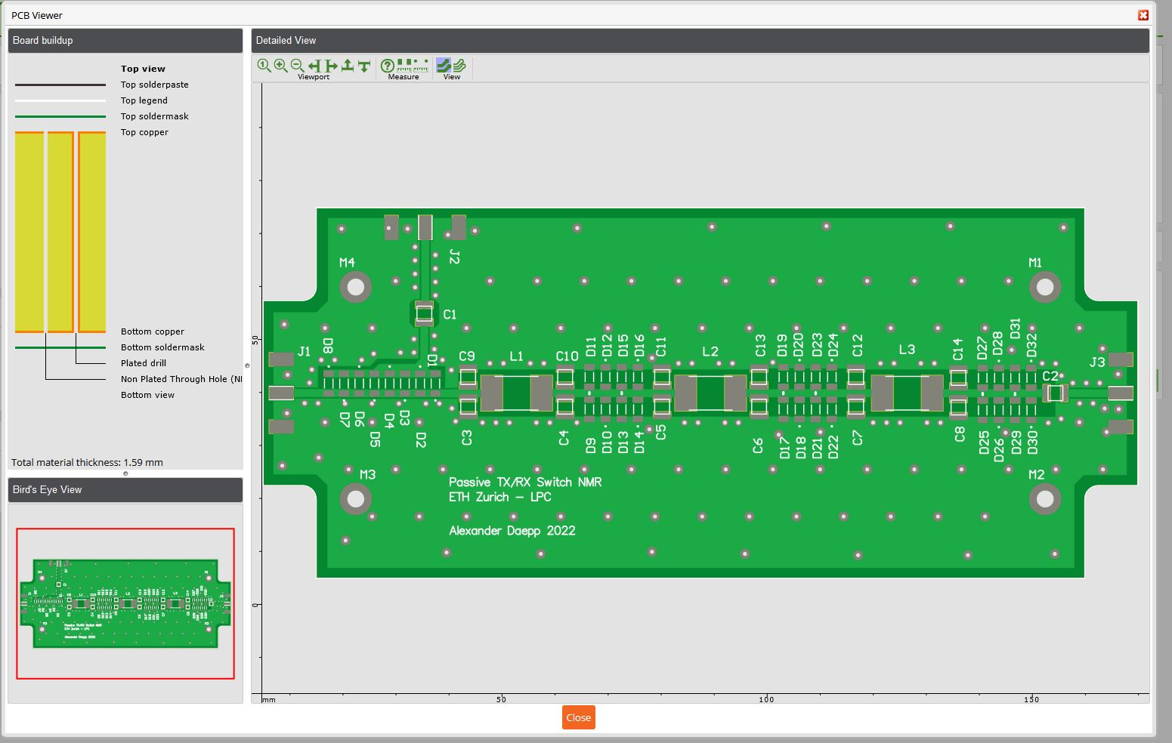
Preamp and Switch
ü
Low-noise amplifier
from Mini-Circuits:
EUR 125
Noise Figure: 2.9 dB
Frequency: 0.1-500 MHz
Albannay (Bannay) Mohammed
Alexander Däpp
Transmit/Receive switch (duplexer)
from Mini-Circuits:

Slide 19
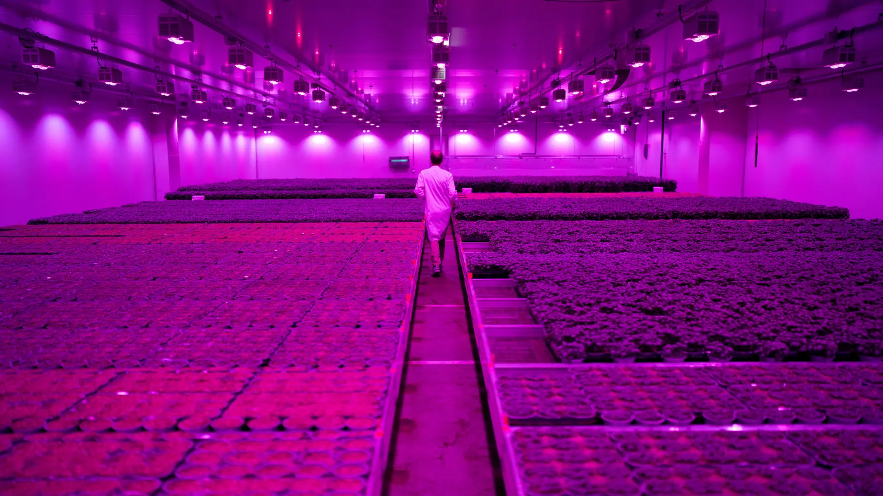
And what about photo-CIDNP?
Use high-power LEDs from Indoor Farming
Source: NZZ (31.10.2022)

Slide 20
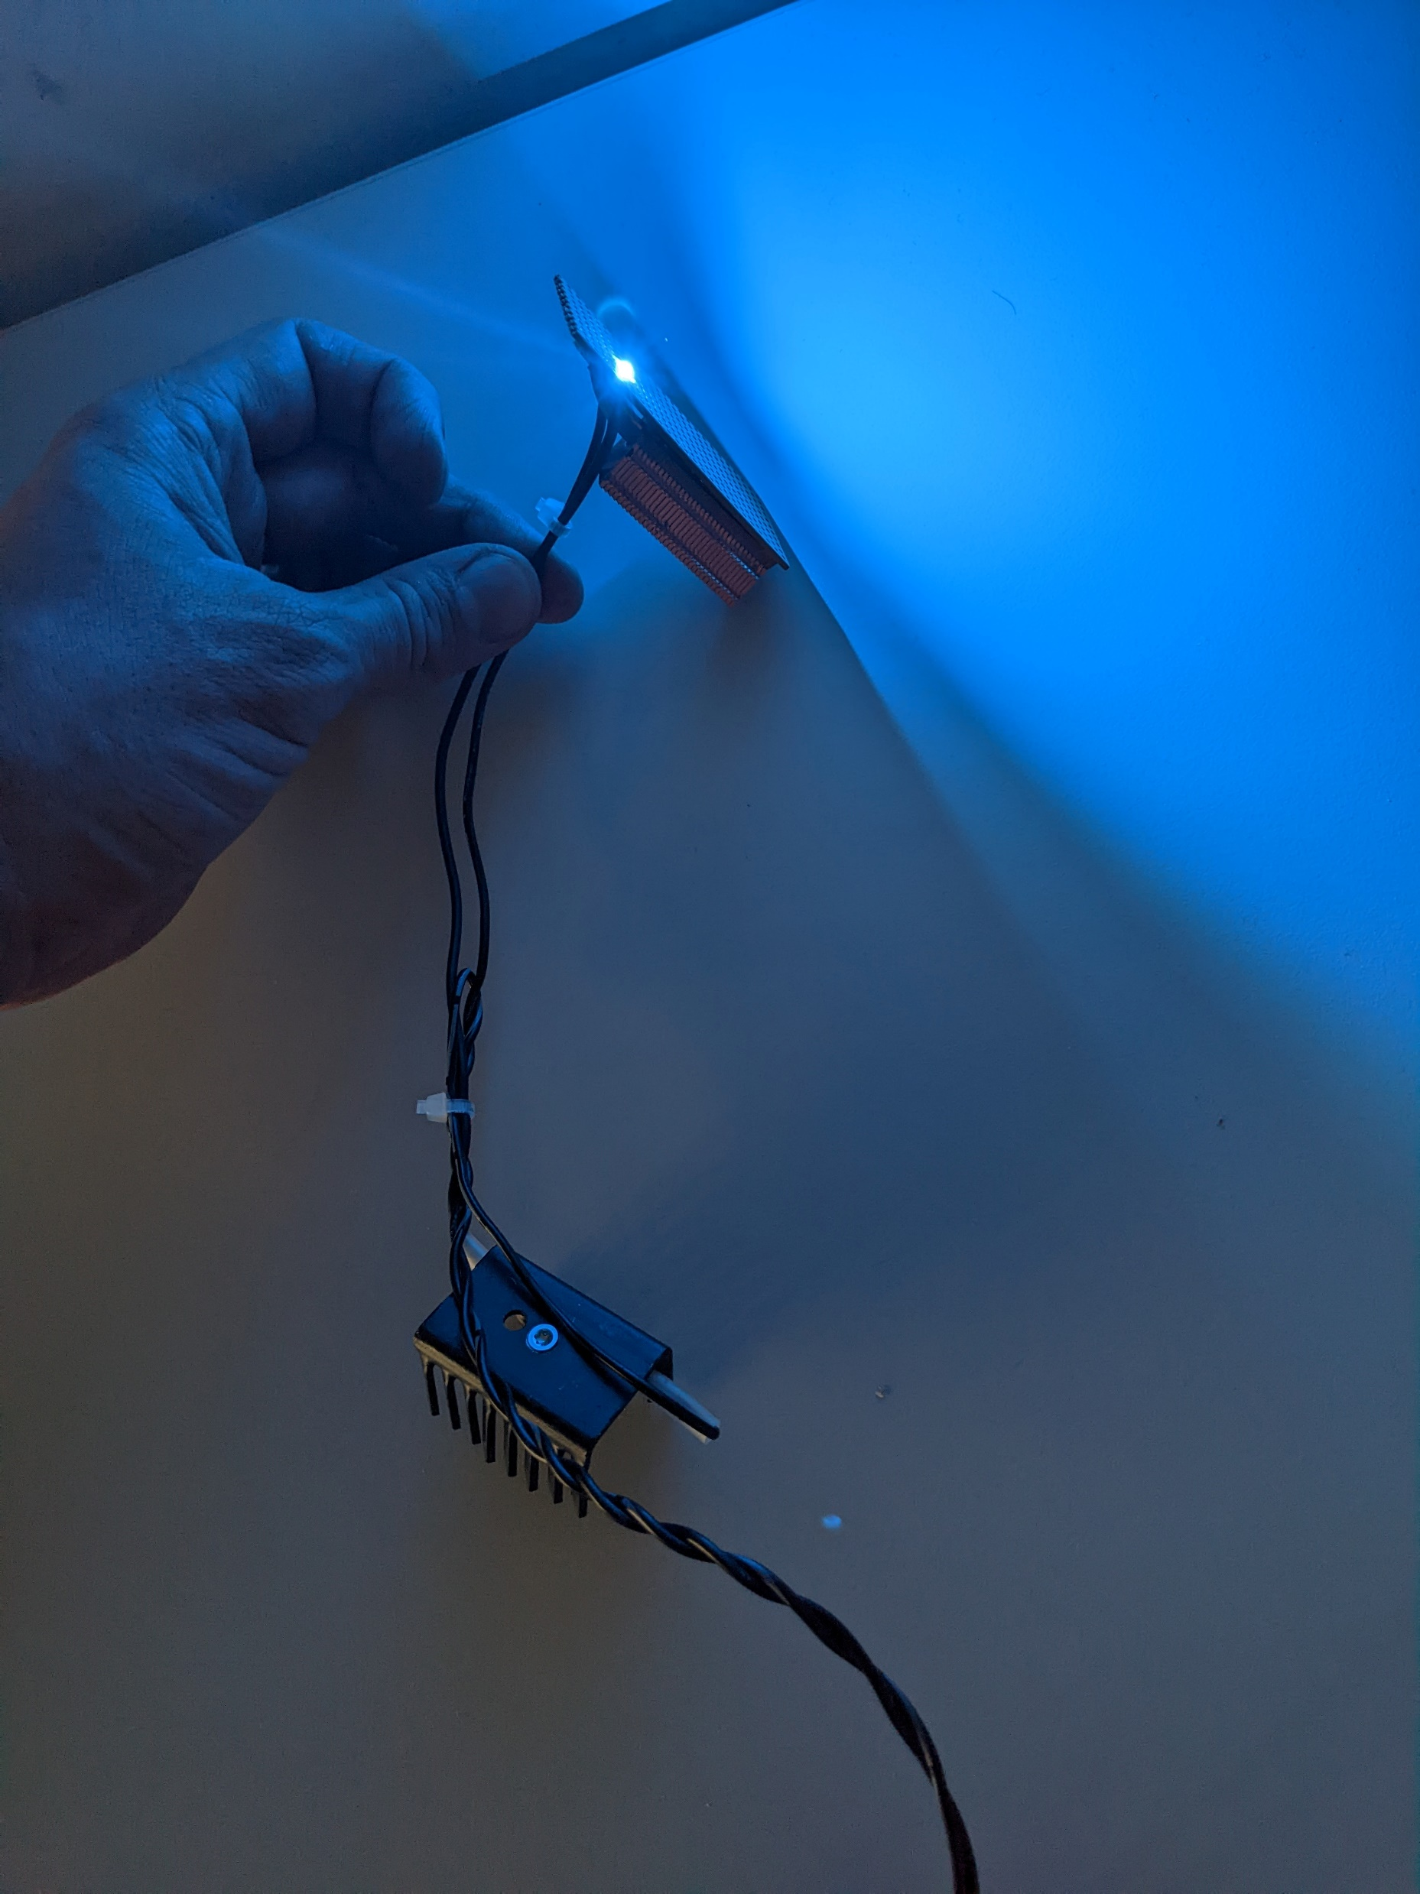
Excite photo-CIDNP with LED
High Power LEDs –
CREE Ltd
XP-E Blue (455 nm), 45.7 lm
CHF 1.60

Slide 21
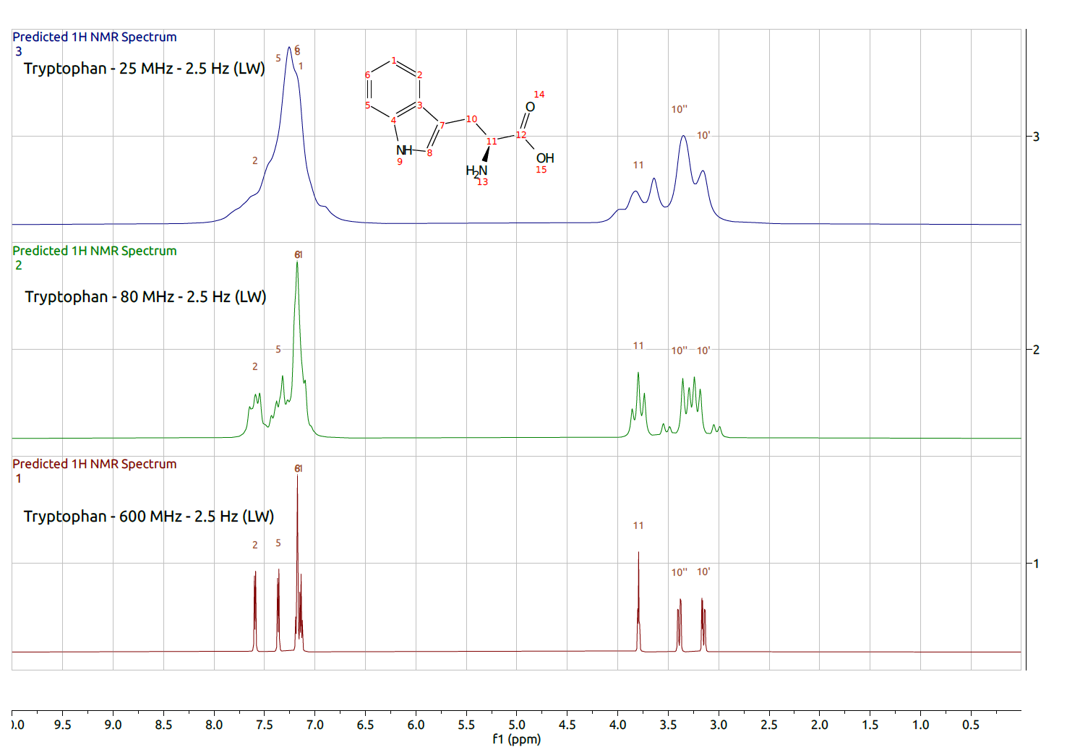
Simulated/Predicted with MNova
Challenge of low-field resolution

Slide 22
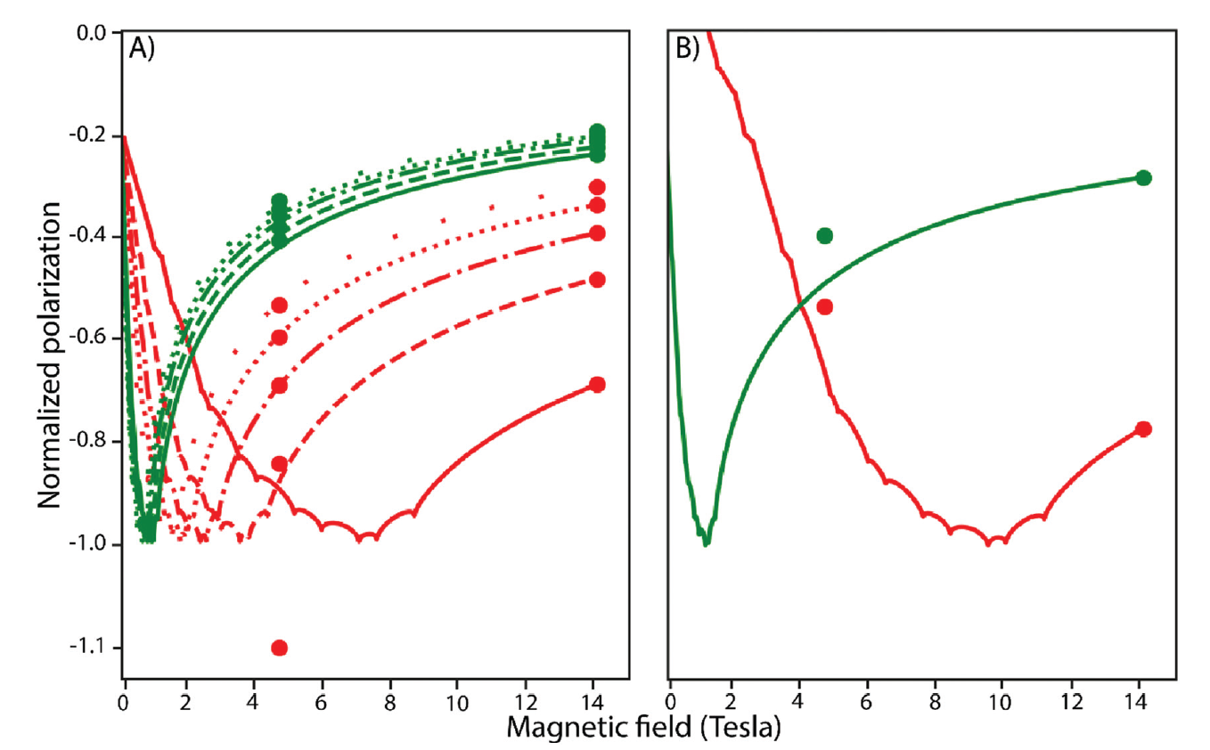
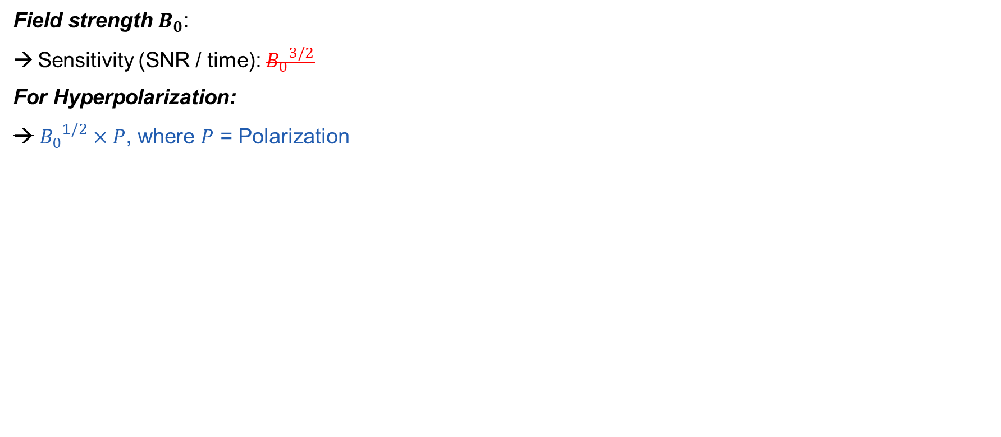
Chances in Sensitivity Enhancement through photo-CIDNP
Field dependence of photo-CIDNP
Field strength $B_{0}$:
Sensitivity (SNR / time): ${B_{0}}^{3/2}$
For Hyperpolarization:
→ ${B_{0}}^{1/2}×P$, where $P$ = Polarization
Different Molecules
Red: HOPI
Green: tryptophan
→ Optimize Dye/Molecule Pair
→ Maximize Polarization
A) AT 12 Different Dyes B) fluorescein
F. Torres, A. Sobol, J. Greenwald, A. Renn, O. Morozova, A. Yurkovskaya, R. Riek , PCCP, 23, 6441 (2021)
.
Notes:
Fig. 5 Field dependent photo-CIDNP polarization calculated from the HFCC of HOPI (red) and tryptophan (green) in the presence of AT12 (A), or
fluorescein (B). The g-value of AT12 is unknown and the curves were simulated for different potential values: 2.0036 (solid), 2.0037 (dashed), 2.0038 (dotdashed),
2.0039 (dotted), and 2.0040 (loosely dotted).

Slide 23
To Do
For advanced NMR users
For non-experienced NMR users
Software / Smartphone App
Temperature insulation/control of magnet → field stability
Automatization: tuning/matching, shimming, locking on water (¹H₂O), pulse calibration, water suppression (pre-saturation)
Spectral simplification: decoupling, ML approaches to extract more information?
Move to 2nd spectrometer prototype with different magnet design
Applications?
Research: photo-CIDNP drug screening → record intensity changes → spectral resolution not crucial!
→ competitive binding with low-field optimized dye/molecule pair
Teaching: «normal» NMR with highly concentrated samples (100 mM)
Decoupling, relaxation measurements
Start a collaboration with a university of the «Global South»

Slide 24
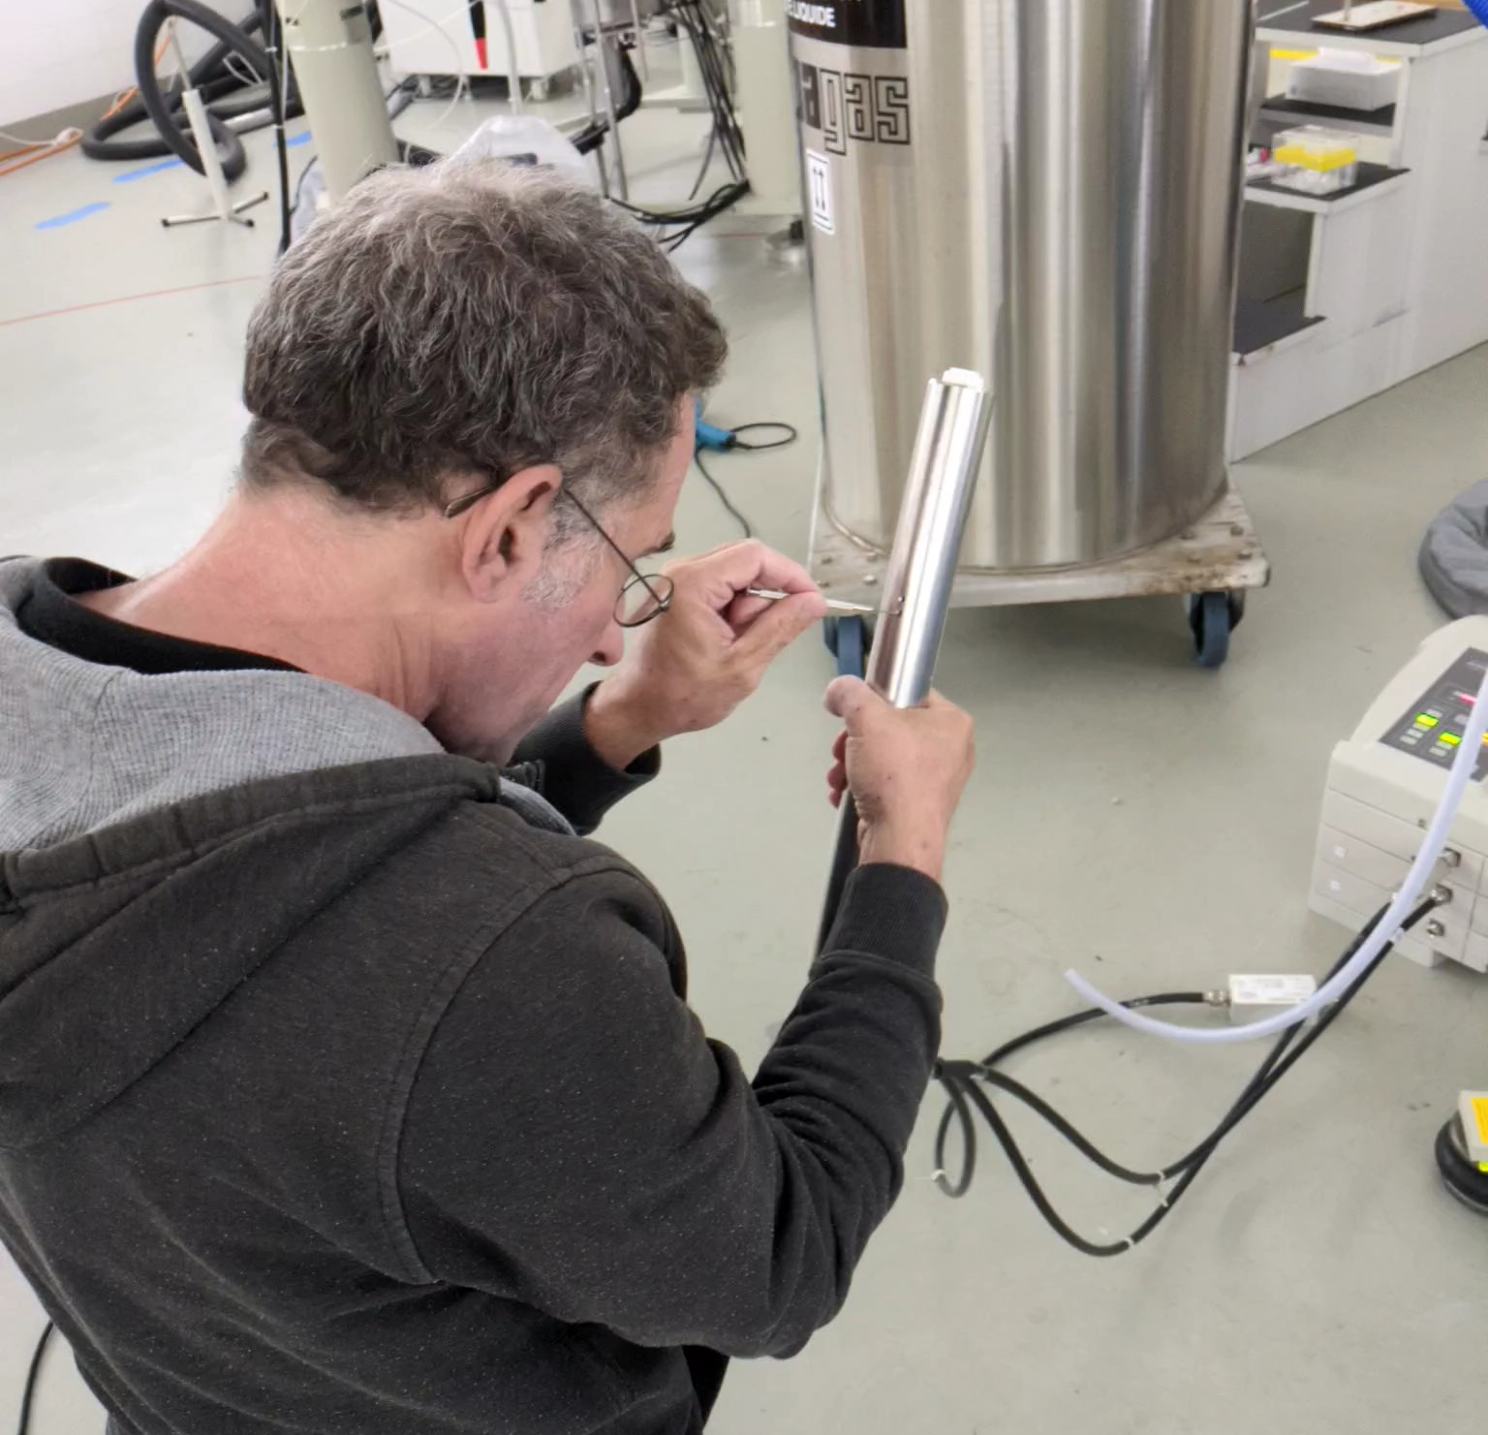
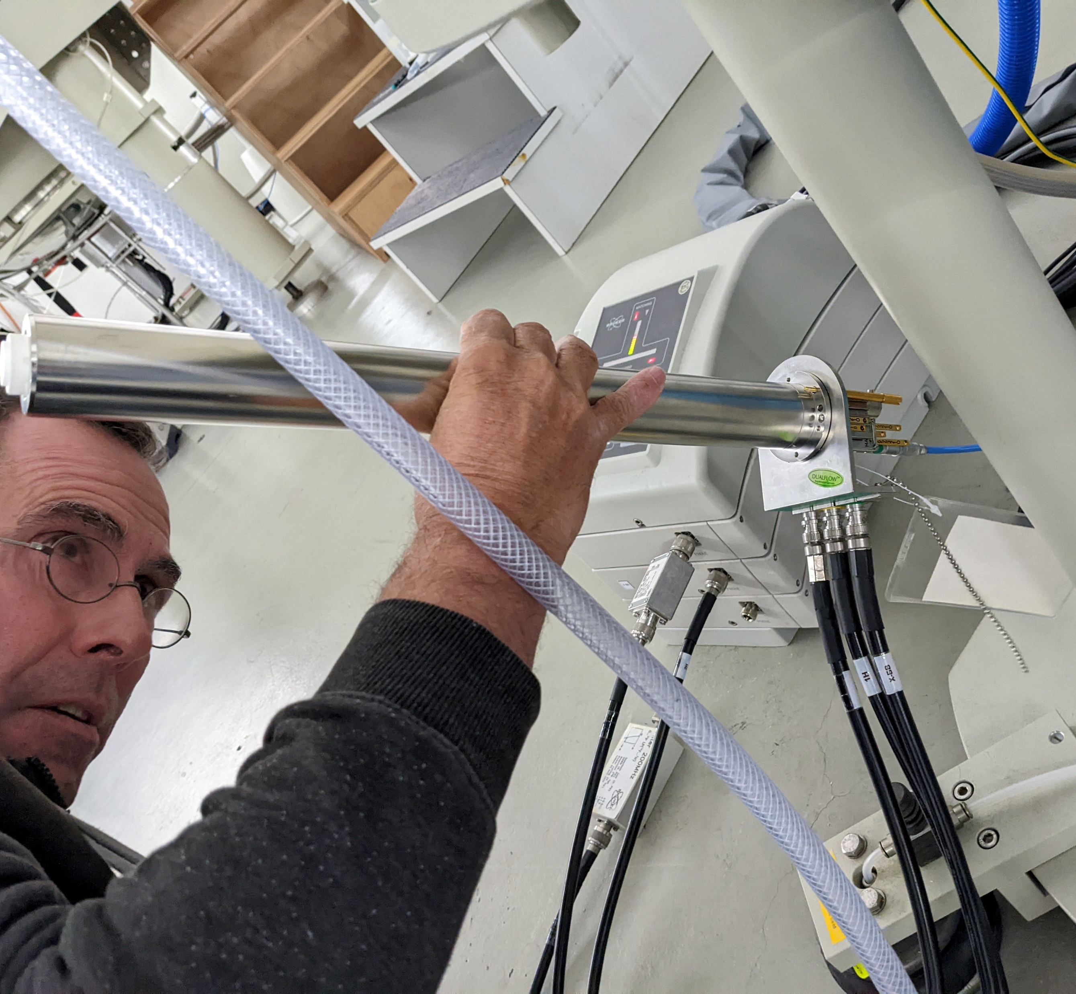
Roland
Thank you!

Slide 25

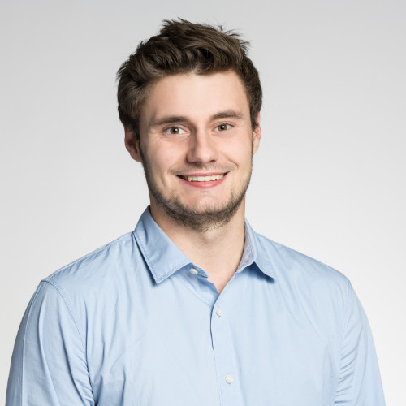
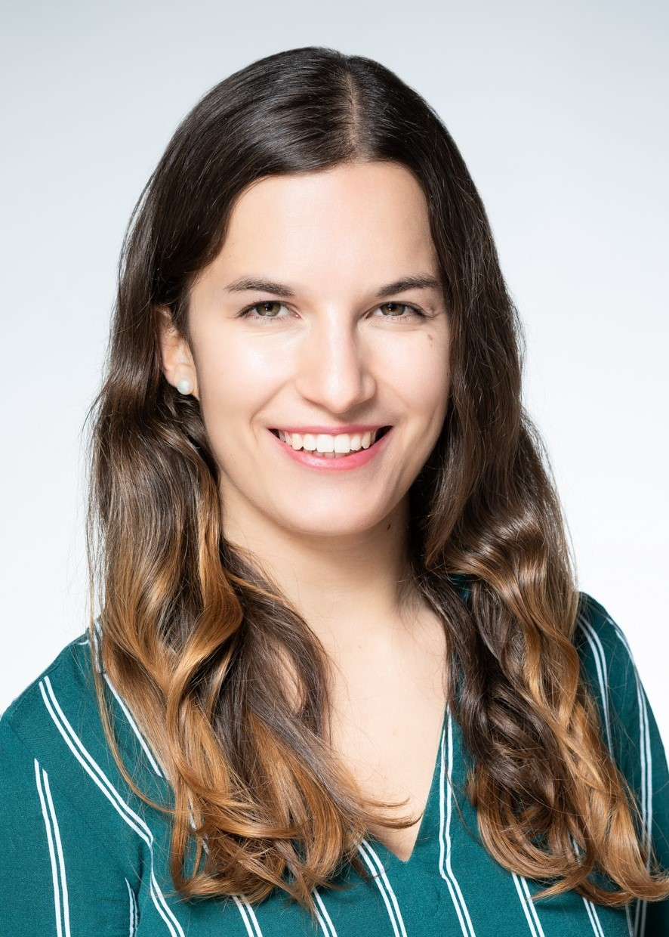
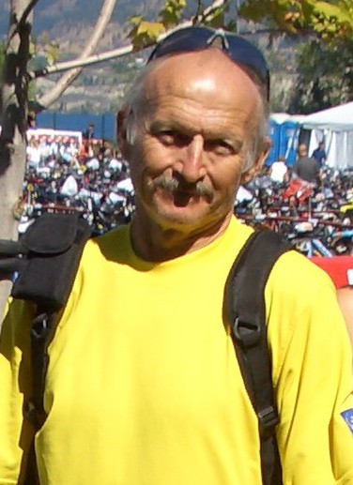
The photo-CIDNP group
Thank you!

Slide 26



Thank you!
Tiago Ferreira
LPC electronics
Alexander Däpp
LPC electronics
Albannay (Bannay) Mohammed
Quad Systems
Vlad Negnevitsky
Oxford Ionics/MaRCoS
Mazin Jouda
KIT
Jan Korvink
KIT

Slide 27
Switzerland: The NMR world power
I remember, in the winter of our first experiments […] looking on snow with new eyes. There the snow lay around my doorstep - great heaps of protons quietly precessing in the earth’s magnetic field.
Purcell, Nobel Lecture, 1952
https://www.nobelprize.org/uploads/2018/06/purcell-lecture.pdf
“A new fascination for the NMR experiment”

Slide 28


